Slide 1
Microsoft® Word 2010 Training
Create your first Word document II
Notes:
[Note to trainer: For detailed help in customizing this template, see the very last slide. Also, look for additional lesson text in the notes pane of some slides.]

Slide 2
Course contents
Overview: Moving along in Word
Lesson: Includes seven instructional sections
Suggested practice tasks
Test
Quick Reference Card

Slide 3

Overview: Moving along in Word
Welcome to the second installment of the “Create your first Word 2010 document” series for those who are new to Word.
In this course, you’ll learn to move around in the document, use formatting marks, move text by using Cut and Paste, and change line spacing and alignment in Word 2010.

Slide 4
Course goals
Move around in the document.
Use formatting marks.
Move text around in the document.
Change line spacing and alignment.

Slide 5
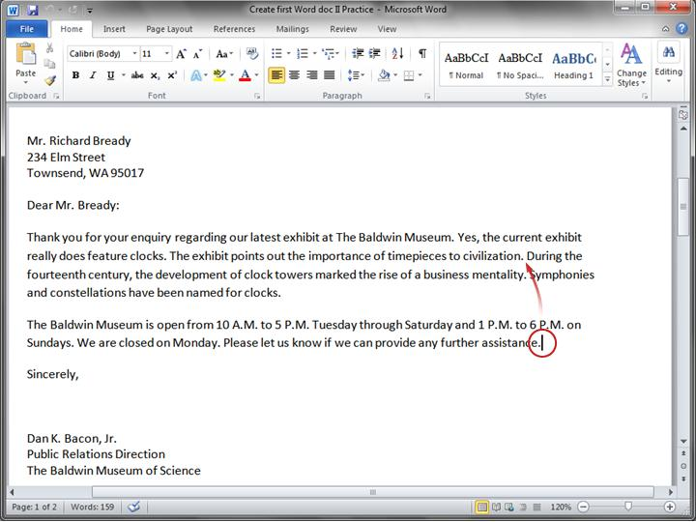
Moving around in the document
Imagine, in this picture, that you want to type a new sentence in the first paragraph between
“civilization” and “During”.
The cursor (the vertical line) is at the end of the second paragraph, after the word "assistance." To type anywhere else in the document, you need to move the cursor to that place.
Move the cursor to another location by moving the pointer and then clicking, or by using the keyboard.

Slide 6
Moving around in the document
Here are a couple of ways to do that:
With your mouse, move the cursor just to the left of “During,” and then click to insert the cursor. Then start typing. Or…
Press the UP ARROW on your keyboard to move the cursor up one line at a time. Then press the LEFT ARROW to move the cursor left, one character at a time.
Move the cursor to another location by moving the pointer and then clicking, or by using the keyboard.
Notes:
Tips:
You can also press CTRL+LEFT ARROW to move left one word at a time. (Keep in mind that in keyboard shortcuts the plus sign (+) is not a key; it just means that you press the LEFT ARROW key while holding down the CTRL key.)
To get a list of the keys you can use to move around the page, see the Quick Reference Card that’s linked to at the end of the course.

Slide 7
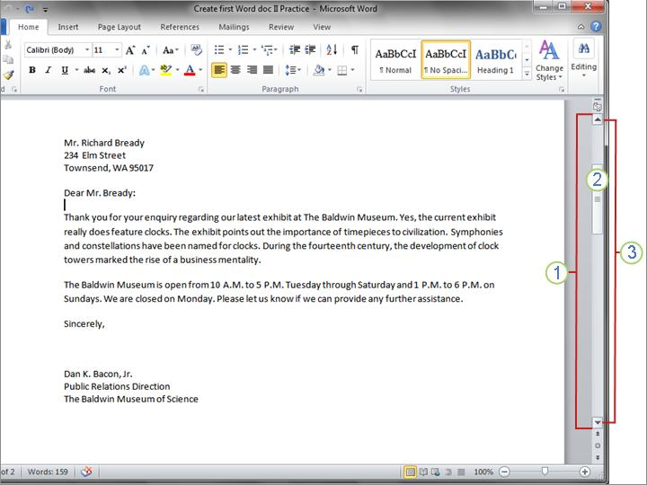
Use the scroll bar
But if your document is getting long, it may not be practical to have to continuously press the arrow keys to move up or down the document. Instead, use the scroll bar.
The scroll bar.

Slide 8
Use the scroll bar
Here’s how it works:
The scroll bar is on the right side of the window.
To use it, click the scroll box, and then drag it up or down to move through a document without moving the cursor.
Or click the single scroll arrows at either end of the scroll bar to move up or down.
The scroll bar.
Notes:
You can also scroll by using your keyboard. Press the PAGE UP key to go up one screen or PAGE DOWN to go down one screen.

Slide 9
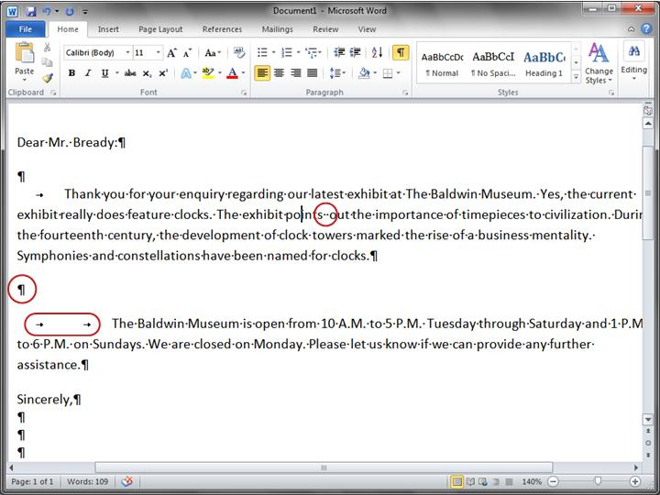
Go behind the scenes with formatting marks
Imagine that you have typed a few paragraphs. The paragraphs seem very far apart, and the second paragraph starts farther to the right than the first paragraph.
You can see what’s going on in your document by looking at the formatting marks that Word automatically inserts as you type. These marks are always in documents, but they are invisible to you until you display them.
Formatting marks in a Word document.

Slide 10
Go behind the scenes with formatting marks
For example, a dot appears every time you press the SPACEBAR, such as between words. One dot is one space; two dots are two spaces, and so on. Normally there should be one space between each word.
Formatting marks in a Word document.

Slide 11
Go behind the scenes with formatting marks
Word inserts a paragraph mark ( ) each time you press ENTER to start a new paragraph. In the picture, there are two paragraph marks between the two paragraphs, which means that ENTER was pressed twice. This creates extra space between paragraphs.
Formatting marks in a Word document.

Slide 12
Go behind the scenes with formatting marks
One arrow ( ) appears each time TAB is pressed. In the picture there is one arrow before the first paragraph and two arrows before the second paragraph, so TAB was pressed twice in the second paragraph.
Formatting marks in a Word document.

Slide 13
Go behind the scenes with formatting marks
To see formatting marks, go to the ribbon, at the top of the window. On the Home tab, in the Paragraph group, click the Show/Hide button
( ). Click the button again to hide formatting marks.
Formatting marks in a Word document.
Notes:
Note: These marks are just for show. They won’t be on printed pages, even when you see them on the screen.

Slide 14
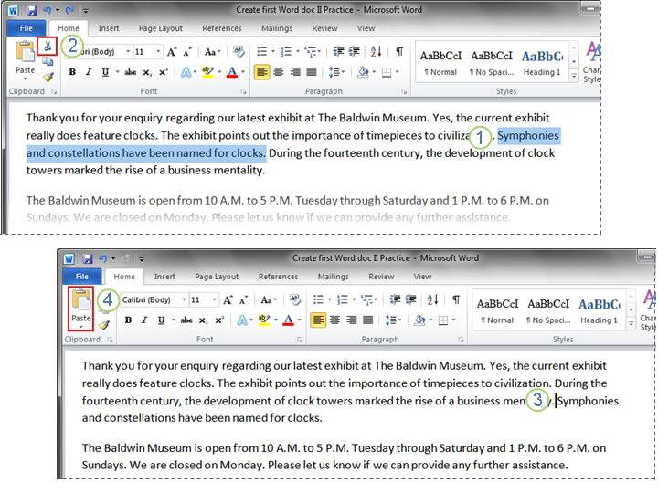
Move text by using Cut and Paste
What if you need to move some text around in the document? You don’t need to delete it and type it again where you want it. Instead, just use Cut and Paste.
For instance, in the first paragraph, you decide that the fourth sentence should be the last sentence in the paragraph.
Don’t delete and retype – use Cut and Paste.

Slide 15
Move text by using Cut and Paste
Select the sentence you want to move, as shown in the picture.
On the ribbon, on the Home tab, Click Cut
( ).
Move the cursor to the end of the paragraph, where you want the sentence to appear (after the dot formatting mark).
On the Home tab, in the Clipboard group, click Paste ( ).
Don’t delete and retype – use Cut and Paste.
Notes:
In steps 2 and 4, you could instead use keyboard shortcuts to do the same thing, by pressing CTRL+X to cut (think of the X as a scissor) and CTRL+V to paste.
Once you start editing documents, you’ll see how fast and convenient these keyboard shortcuts are.

Slide 16
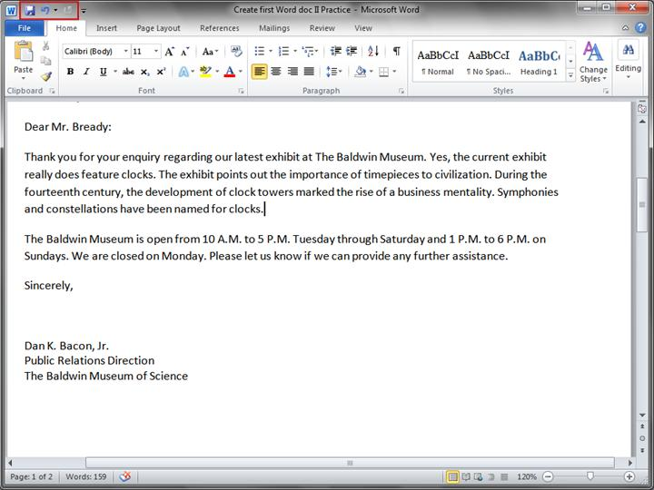
Undo!
You’ve moved the sentence, but now that you look at it, you’re not happy with the change. Fortunately, you don’t have to go through the entire cut-and-paste process again to move the sentence back to its original place. Instead, use Undo.
On the Quick Access Toolbar at the very top of the window, click the Undo button ( ).
The Undo button on the Quick Access Toolbar.

Slide 17
Undo!
This will undo the last action you took, which in this case was pasting the sentence in the new location.
Click the Undo button again to undo the previous action, which in this case was cutting the sentence from its original location. Now your sentence is back in its original location.
The Undo button on the Quick Access Toolbar.
Notes:
Or, to use another handy keyboard shortcut, press CTRL+Z twice to do the same thing.

Slide 18
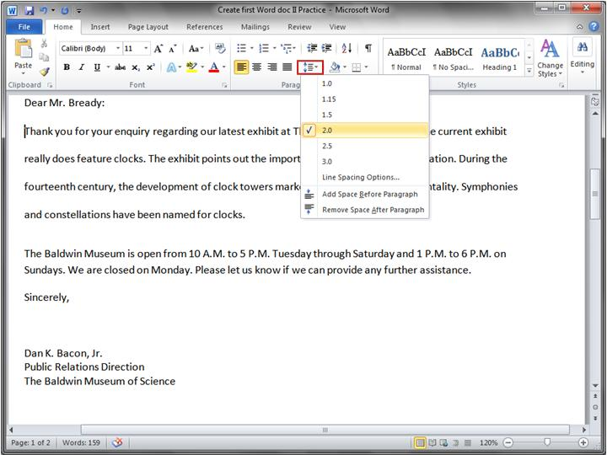
Line spacing
You can adjust how much space is between lines of text. If you’d like more or less space between lines throughout a document, or in a selected area of text, such as in a letter address, it’s easy to change the spacing.
Changing line spacing in a document.

Slide 19
Line spacing
To change the line spacing for an entire document, you need to select all the text in the document by pressing CTRL+A.
To change line spacing for a single paragraph, you can just place the cursor inside the text; you don’t have to select the text.
Changing line spacing in a document.

Slide 20
Line spacing
Then, on the Home tab, in the Paragraph group, click Line Spacing ( ).
A check mark in the list tells you what the current line spacing is. Click the new line spacing you want.
Changing line spacing in a document.

Slide 21
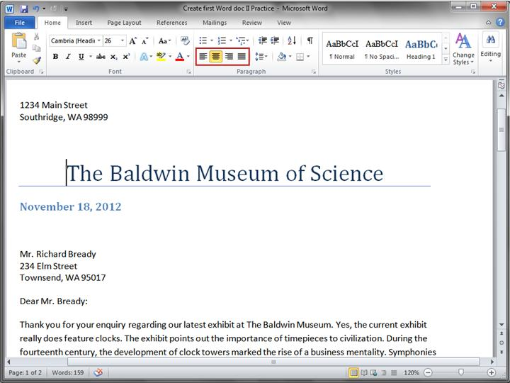
Align text left, center, or right
Horizontal alignment determines the appearance and orientation of the edges of the paragraphs.
Text can be left-aligned, which means the left edge of the text is flush with the left margin; right-aligned; centered; or justified, which means it’s aligned evenly along the left and right margins.
The Align buttons.

Slide 22
Align text left, center, or right
The most common alignment is left-aligned, but you can change it to whatever you want, for a single paragraph, a set of paragraphs, or the entire document.
For example, in many documents, titles are centered in the middle of the page.
The Align buttons.

Slide 23
Align text left, center, or right
Select the text that you want to align, or press CTRL+A to select all the text in the document.
Then, on the Home tab, in the Paragraph group, click Align Left ( ) or Align Right ( ), Center ( ), or Justify
( ).
The Align buttons.

Slide 24
Suggestions for practice
Move around in the document.
Turn on formatting marks.
Use Cut and Paste to move text, and use Undo.
Change line spacing.
Align text.
Online practice (requires Word 2010)
Notes:
[Note to trainer: With Word 2010 installed on your computer, you can click the link in the slide to go to an online practice. In the practice, you can work through each of these tasks in Word 2010, with instructions to guide you. Important: If you don’t have Word 2010, you won’t be able to access the practice instructions.]

Slide 25
Test question 1
To move through a document, you must press the DOWN ARROW key to get from the top to the bottom of the document. (Pick one answer.)
True.
False.

Slide 26
Test question 1
To move through a document, you must press the DOWN ARROW key to get from the top to the bottom of the document.
Answer:
False.
Scrolling through the document or using the PAGE UP and PAGE DOWN keys are quicker ways to read through a document.

Slide 27
Test question 2
Press the BACKSPACE key to remove extra formatting marks. (Pick one answer.)
True.
False.

Slide 28
Test question 2
Press the BACKSPACE key to remove extra formatting marks.
Answer:
True.
If it looks like you have unwanted spaces in your document, turn on formatting marks to see what’s going on behind the scenes.

Slide 29
Test question 3
To move text from one location to another, copy the text. (Pick one answer.)
True.
False.

Slide 30
Test question 3
To move text from one location to another, copy the text.
Answer:
False.
To move the text to another place, select and then cut the text. Then paste it in the new location.

Slide 31
Test question 4
After you’ve cut text, you can’t get it back. (Pick one answer.)
True.
False.

Slide 32
Test question 4
After you’ve cut text, you can’t get it back.
Answer:
False.
Click the Undo button or paste the text back in.

Slide 33
Quick Reference Card
For a summary of the tasks covered in this course, view the Quick Reference Card.

Slide 34
Using this template
See the notes pane or view the full notes page (View tab, Notes Page) for detailed help on this template.
Notes:
Using This Template
This Microsoft PowerPoint® template has training content for those who are new to Word about moving around in a document, using formatting marks, moving text, and changing line spacing and alignment in Word 2010. Its content is adapted from the Office.com Training course called “Create your first Word document II.”
Slide layouts: Each slide has a custom layout. To apply the custom layout to a new slide, right-click the slide thumbnail, point to Layout, and click the layout from the Layout gallery. To alter the layouts, open master view and alter the specific master layout in that view. You can find the layout’s title by pointing to its thumbnail.
Animations: Custom animation effects are applied throughout the presentation. These include Float In (Up or Down option), Fade, and Zoom. To alter animation effects, click the Animations tab, and use the Add Animation gallery and Timing options. Effect Options gives you choices about the effect; click Animation Pane on the Animations tab to work with multiple animations.
Transitions: One transition, Doors, is used to emphasize sections of the slide show. It’s applied on the Course Contents slide, Lesson slide, and the first test slide.
Hyperlinks to online course: The template contains links to the online version of this training course. The links take you to the hands-on practice session for each lesson and to the Quick Reference Card that is published for this course. Please take note: You must have Word 2010 installed to view the hands-on practice sessions. If you don’t have Word 2010, you won’t be able to access the practice instructions.
Headers and footers: The template contains a footer that has the course title. To add footers such as the date or slide numbers, click the Insert tab, and click Header & Footer.

